Slide 1
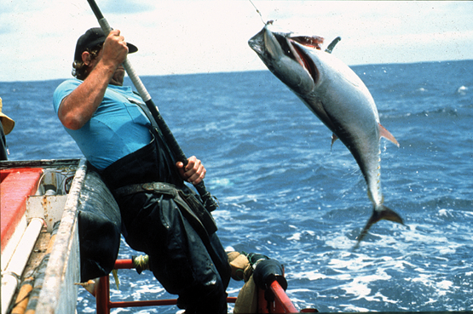
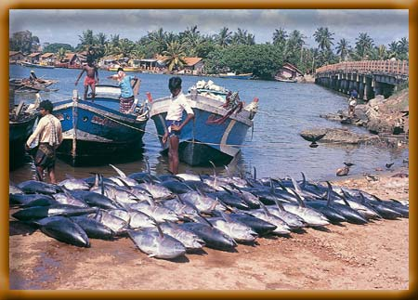

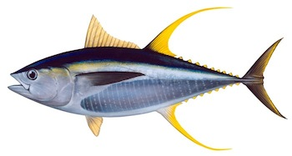
IOTC–2020–WPM11–12 IOTC Yellowfin Management Strategy Evaluation: October 2020 Update Dale Kolody Paavo Jumppanen Jemery Day CSIRO Oceans & Atmosphere, Australia

Slide 2
Outline
Software and documentation available from:
https://github.com/pjumppanen/niMSE-IO-BET-YFT/
Current status of reference set OM
Issues encountered in last iteration
What plausibility diagnostics should we be using?
Workplan proposal

Slide 3
Things to keep in mind
Aiming for an inclusive effort across the IOTC scientific community, highly dependent on the relevant experts
Draft YFT MP resolution circulated to 2019 TCMP & Commission (under further development)
OM reconditioning – when is it required?
takes a lot of time away from other tasks (e.g. MP development)
Want to avoid being stuck in an endless loop (Butterworth’s “guillotine”)
New insights from 2020 revised assessments?
YFT/BET MSE support funding ends July 2021

Slide 4
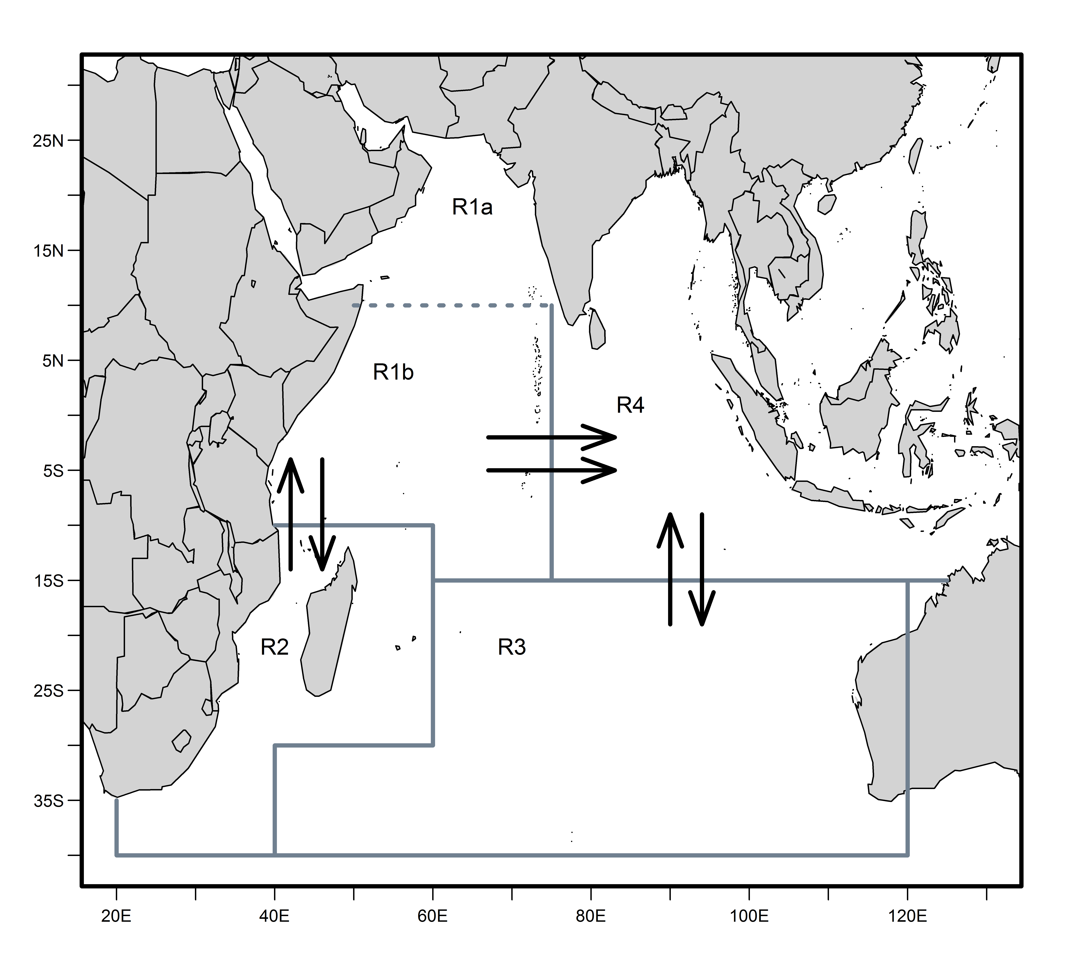
YFT (2018) assessment and 2019 OM
Fu et al. (2018)
Stock Synthesis (Methot and Wetzel 2013)
4 Areas Quarterly dynamics 1952-2017
25 fisheries (21 + time changes)
Age-structured
Spatial BH Recruitment
Emphasis on MPD (best) estimates
Key differences between assessment and OM conditioning assumptions:
Environmental indices not used for OM migration (i.e. hard to project)
OM initial N = Assessment final N + age-dependent error
Uncertainty “grid” ensemble with 11 dimensions in OM

Slide 5
What happened in 2019-2020?
WPTT/WPM Requests for OM update in relation to revised 2020 yellowfin assessment
2020 revised yellowfin assessment was aborted at the end of WPTT 2020 – implications for OM not discussed at the time
Attempt to address WPTT requests revealed various problems
MSE Task Force (and TCMP) cancelled
No feedback since WPTT/WPM 2019.

Slide 6
WPTT/WPM 2019 Yellowfin OM Requests
unresolved issues
Given the 2019 assessment was aborted, not obvious that the OM should be updated
Concerns forwarded to 2020 assessment team

Slide 7
Unresolved Issues 1: Spatial Structure
2 area structure implications
With no movement, why accept a quota cut if the depletion problem is in a separate population?
If tags excluded from 2 area models, tags only given full weight in 17% of grid
Independent Q by region undermines the intent of CPUE regional scaling factor analysis
What does stock structure project say?
Urtizberea et al 2020 – 83% of “retained” models were 4 area configuration

Slide 8
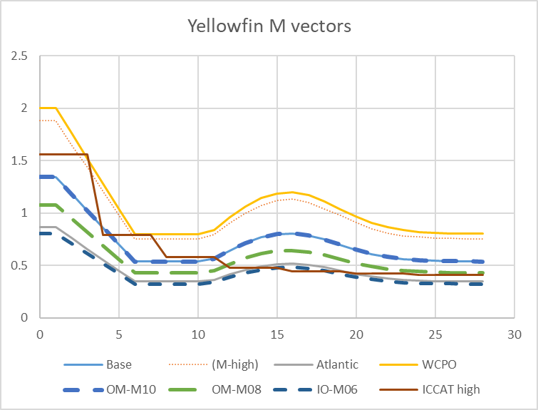
Unresolved Issues 2: Natural Mortality
M06, M08 & M10 used in OM previously:
Atlantic and M06 almost the same, why not retain M06 derived from IOTC tags?
Since 2008, high WCPO M has been dismissed in assessments
“…extreme values of M were eliminated… high M scenario produced model estimates that were not consistent with the known biology (i.e. maximum age) of yellowfin tuna.”

Slide 9
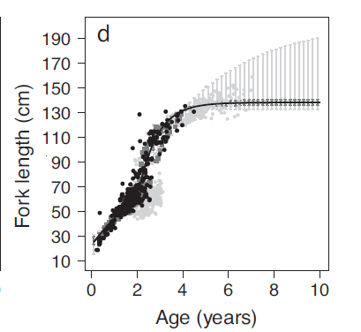
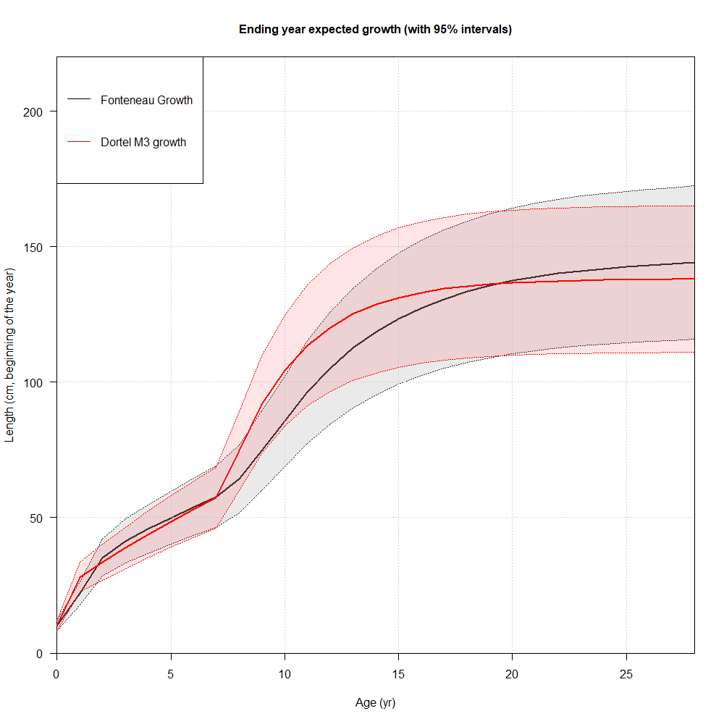
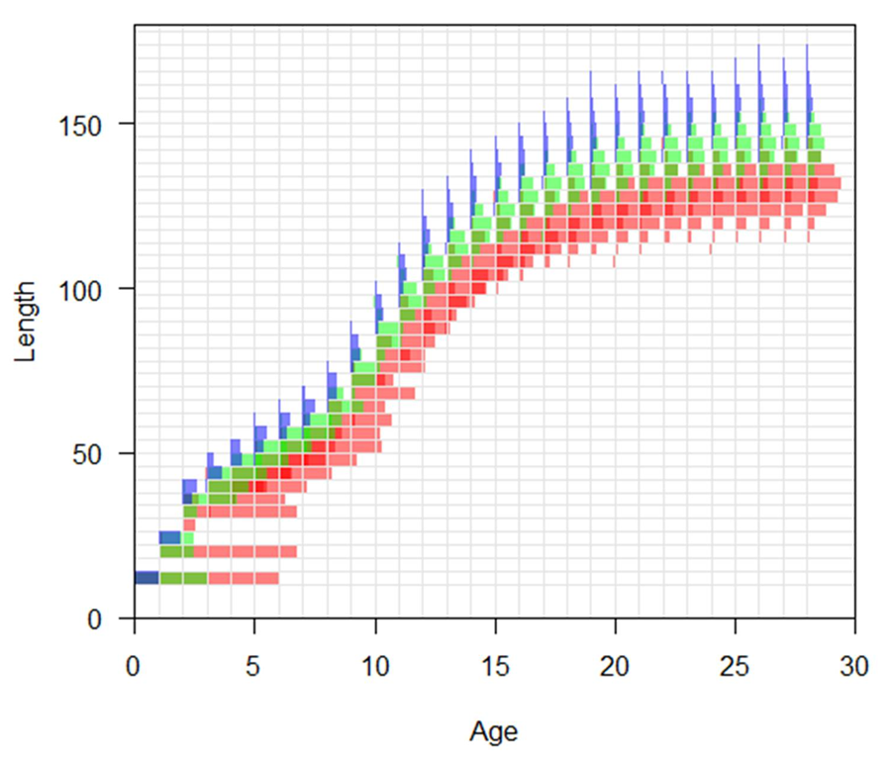
Unresolved Issues 3: Dortel model 3-lognormal
Stock Synthesis cannot describe Variance-at-age very well
Does it matter? Is Dortel variance plausible?
SS platoons or morphs might help, but there is a cost
Urtizberea et al 2020
SS representation (red)

Slide 10
Unresolved Issues 4: Alternate CPUE Series
2019 CPUE Working group did not update the previous “alternative” series
Suggested item for CPUE working group ToR (2021?):
Identify a small number of alternate CPUE series that encompasses the plausible range of uncertainty in relative abundance that the group feels is important to represent in Management Procedure Evaluation. Ideally, this should include i) standardization approach, ii) regional scaling factors, and iii) unaccounted for catchability trend hypotheses.

Slide 11
What did we achieve wrt: Yellowfin MSE ?
1) CPUE discontinuity fixed

Slide 12
2. CPUE discontinuity resolved
(2019 slide)
MP must always use the same observed CPUE series.
OM 2 not consistent with CPUE 2
Current approach calculates q based on whole time series means
CPUE 1 (MP uses this series)
Vulnerable Biomass 2 (fits CPUE 2)
Relative abundance
Two changes to MSE code:
CPUE projection error characteristics tied to individual SS models in OM
Rare recruitment anomalies fixed by constraining recent recruitment for 12 quarters
Time

Slide 13
What did we achieve wrt: Yellowfin MSE ?
Useful for a small proportion of outlier models
No obvious fix for YFT assessment and OM issues
1) CPUE discontinuity fixed
2) Explored options for resolving the retrospective problem:
Iterative reweighting
CPUE Hyperdepletion
3) Explored high Longline F as a model plausibility diagnostic (see text)
4) Explored environmental links as a mechanism for supporting seasonality and reducing high F

Slide 14
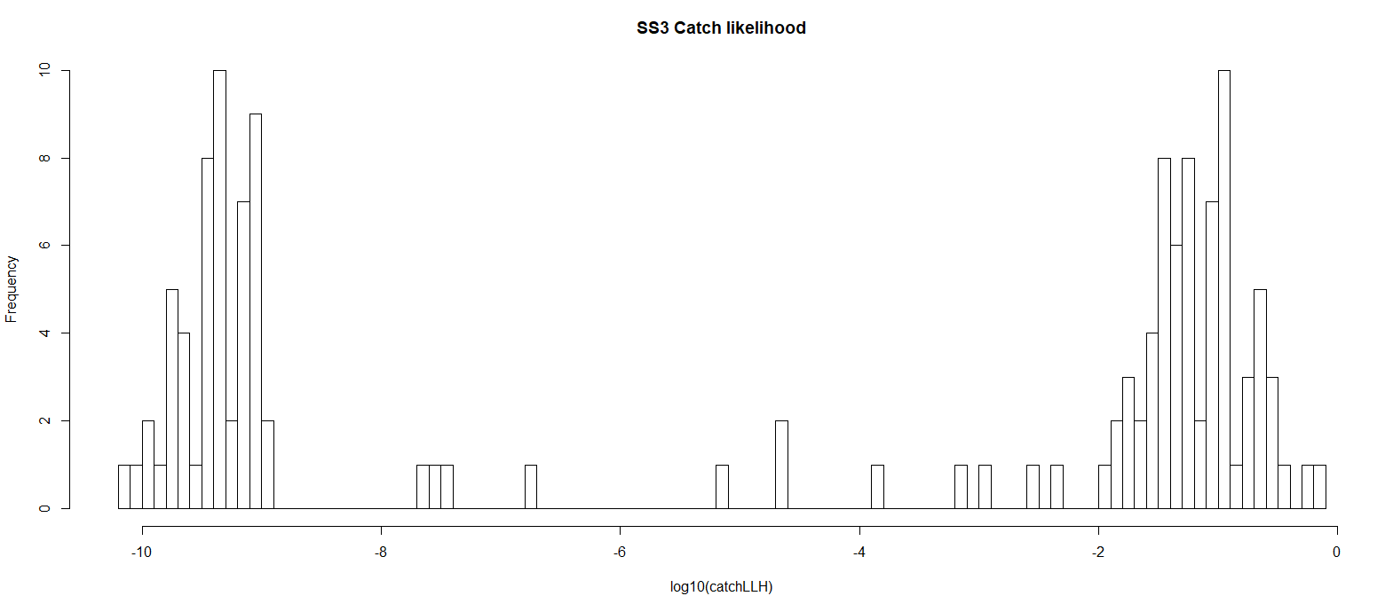
Very high F in some age/region strata
F < 2.9
H < 0.95
F > 2.9
H > 0.95
Probably indicates something is not realistic in the model
Should an implausibility threshold be adopted for rejection ?
How high is too high?
Ignorable artefact of poor seasonal dynamics?

Slide 15
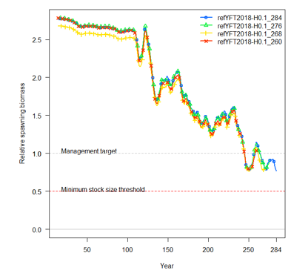
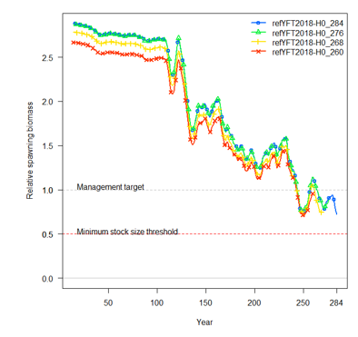
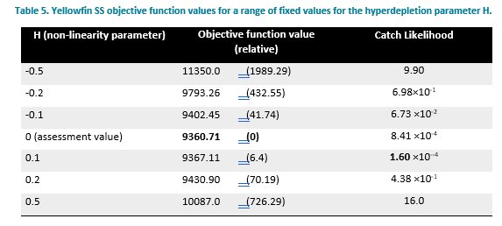
Can we resolve high F and retrospective problem with hyperdepletion?
H = 0.1
H = 0
Good Retrospective
Worse Retrospective
Worse Likelihood
Better Likelihood

Slide 16
Iterative reweighting
Formal approach used in Pacific Fishery Management Council (2018)
Typically involved 5-7 iterations
Approach did not consider tags
Conclusions:
Very slow if applied to all elements of a grid
Reweighting effect not very important for uncertainty relative to the grid.

Slide 17
Seasonal environmental links averaged over years
Potential mechanism for introducing seasonal movement (including in projections)
Potential for reducing F in critical time/area strata
Did not have much effect

Slide 18
Proposed Yellowfin Reference Set OM – (depending on new insights from 2020 assessment)
Again using fractional factorial design to include more uncertainty dimensions
Repeated (X3) minimization to reduce impact of sensitivity to initial parameters

Slide 19
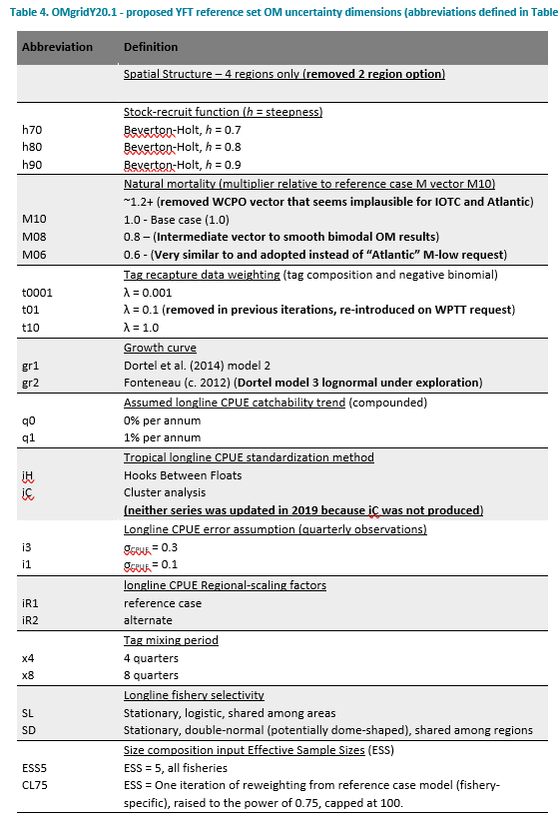
YFT reference set OM dimensions
2020 proposal for 2021 TCMP
WPTT 2019 Proposal for 2020 TCMP
?
?
?
?
?

Slide 20
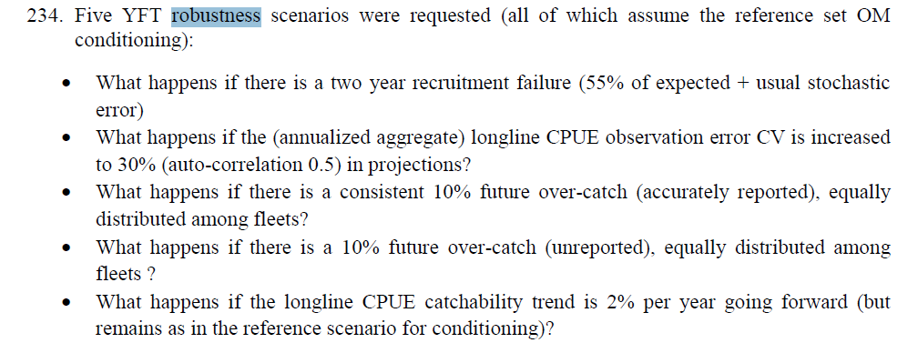
Robustness tests (no changes proposed in 2019)
WPTT 2019

Slide 21
Yellowfin MSE Questions for WPM & WPTT (should be considered in relation to yellowfin assessment update discussion)
Endorsement of CPUE discontinuity resolution?
Modifications to OM Reference Set Grid?
Robustness tests?
SS 3.24 vs 3.30; Length-based selectivity not supported
Revised approach to Plausibility Evaluation?

Slide 22
Plausibility diagnostics & Model Ensembles
What is the purpose of the model?
Stock Assessment –
“Best” model(s) with optimal bias-variance trade-off?
MSE Operating Model –
Plausible ensemble of models that span a range and ensure MPs are robust?

Slide 23
Bias-Variance trade-off in model inference
Ideal model
Low Bias
High Precision
Probably not achievable with existing data
Probably cannot know if it had been achieved
Simple model
Higher bias
Lower variance
Optimal trade-off for “best” model
More realistic model
Lower bias
Higher variance
Stock assessment
Somewhere over here
Operating Model
Somewhere over here

Slide 24
Largely qualitative inspection of OM ensemble models to date
1) “Reasonable” fit to data and assumptions?
CPUE
Catch-at-Length
Recruitment deviations
Tags – unweighted fit index
Catch likelihood
2) Close inspection of “corners”
- extremes of depletion
- extremes of productivity
- standard r4ss plots
3) Model weighting / rejection:
- redundant or problematic uncertainty dimensions dropped
- rare outliers sometimes removed
- very high F has been used previously

Slide 25
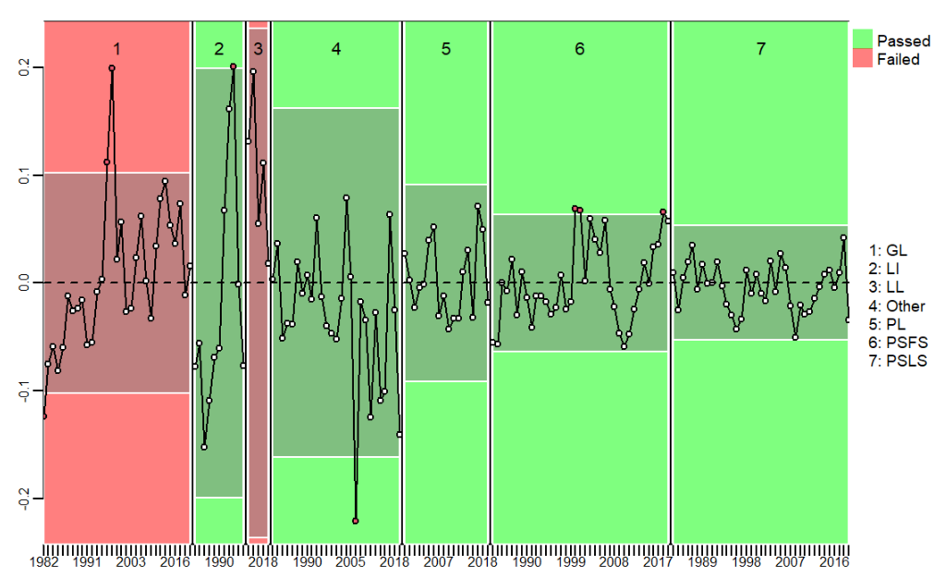
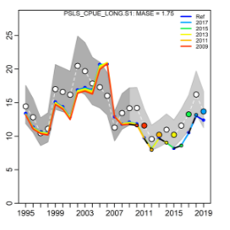
Role of “New” diagnostics in OMs?
Runs test
Retrospectives
Hindcast predictions
Evaluate internal model consistency
Internally-consistent model might still be based on flawed data and assumptions.

Slide 26
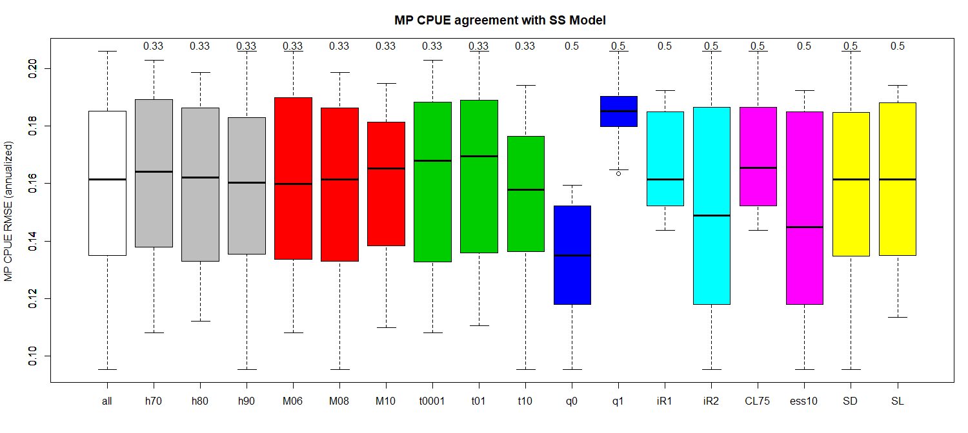
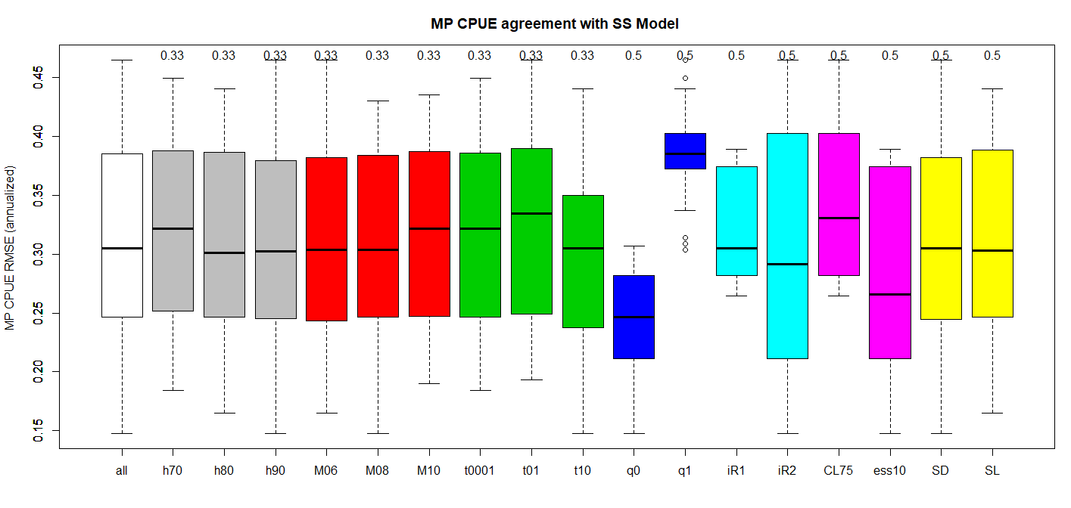
BET example fits to CPUE
Throw out model and WPTT/WPM dimension request?
CPUE RMSE
What if diagnostics threshold recommends dropping alternate CPUE series?
CPUE auto-correlation
Attempt to restructure each model
e.g. iterative reweighting, etc?

Slide 27
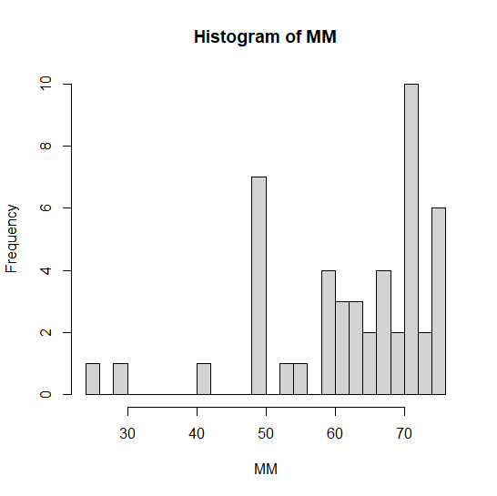
New diagnostics do not remove need for subjective decisions Relative importance of each diagnostic? Retention Rejection thresholds?
Urtizberea et al 2020 grid
mean diagnostic distribution
Proposed stock assessment
threshold
Drop outliers for OM?
All diagnostics met
100%

Slide 28
Computational challenges on new diagnostics
Retrospectives require ~5 model fittings each
For the OM, we already jitter minimization X3+, due to minimization sensitivity
Apply to some extreme corners and assume intermediate is okay?

Slide 29
Merci Thanks!
With thanks to the Australian Department of Foreign Affairs and Trade and FAO/IOTC for funding support, and the WPTT, WPM, TCMP and MSE Task Force for constructive engagement, and the legacy of countless clever modellers, statisticians, computer scientists and biologists upon which everything is built.

Slide 30
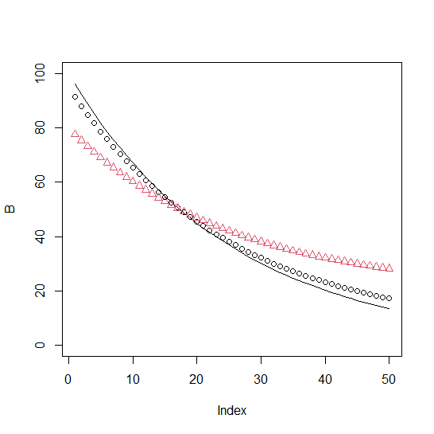
Should we be adding the new suite of assessment diagnostics? Should the assessment be adding other diagnostics?
Runs test
Do black and red have same runs test result?
Clearly red fit is more of a problem?

Slide 31
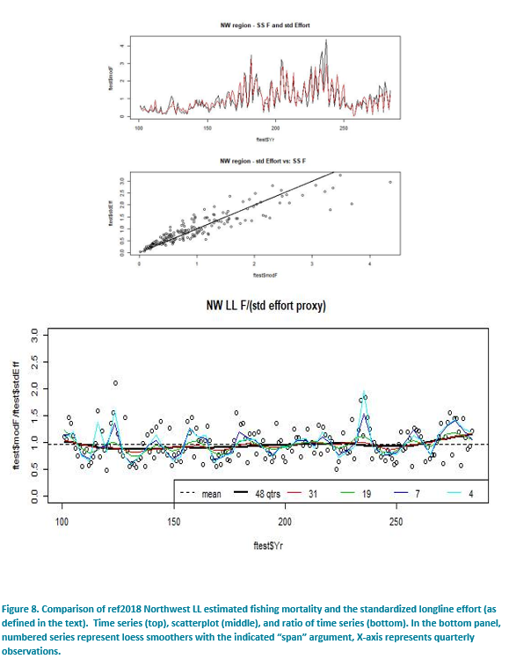
Fishing mortality diagnostic
Curious ~ 4.5y cyclical pattern in the deviation between LL fishing mortality and LL effort
Calculation is over-simplified for intended purpose
But no obvious reason why it would produce cycles.

Slide 32
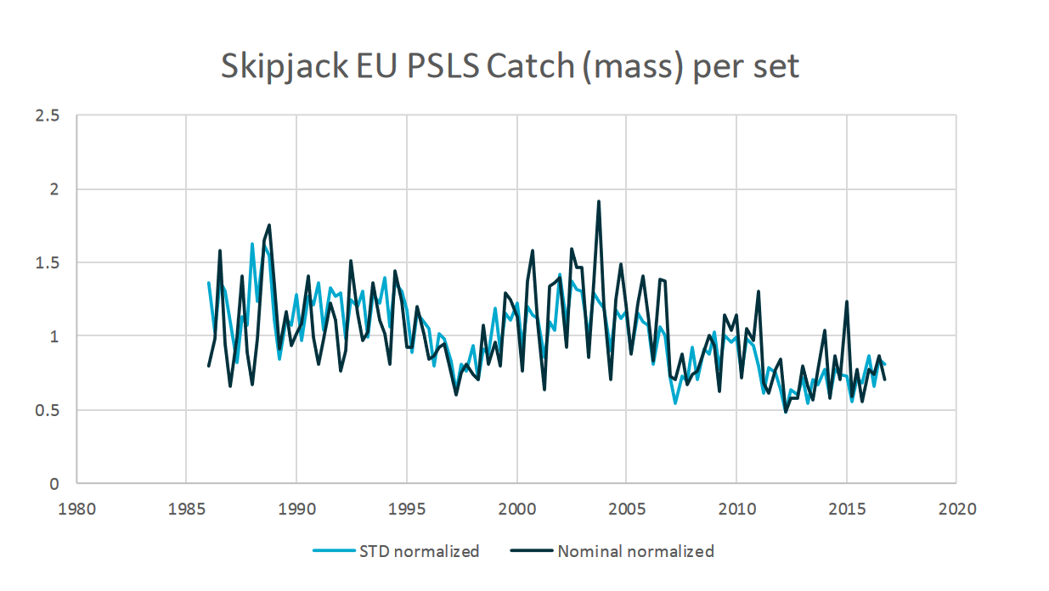
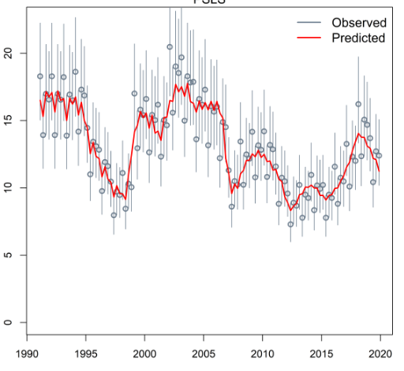
WPTT20-32 vs: WPTT22-10 PSLS CPUE

Slide 33
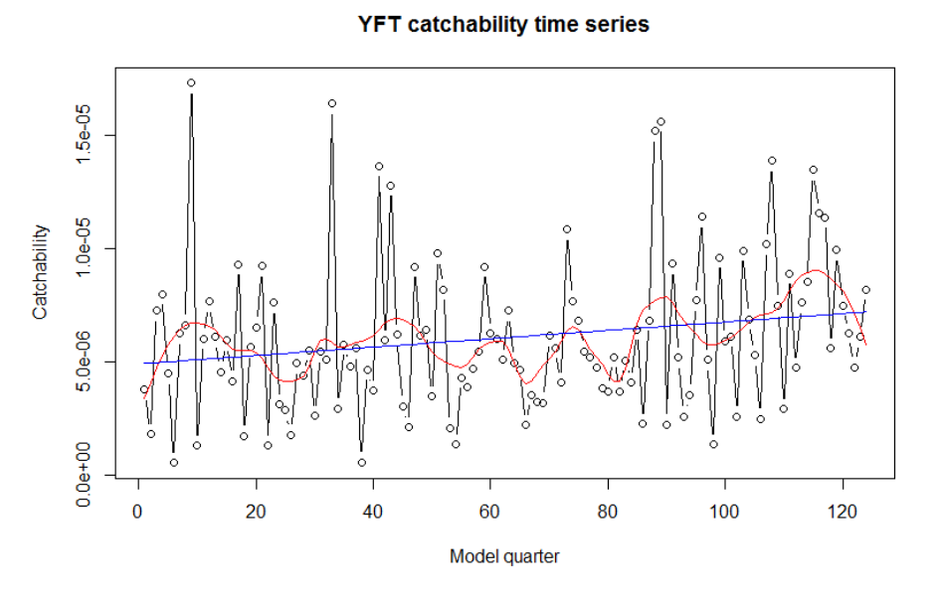
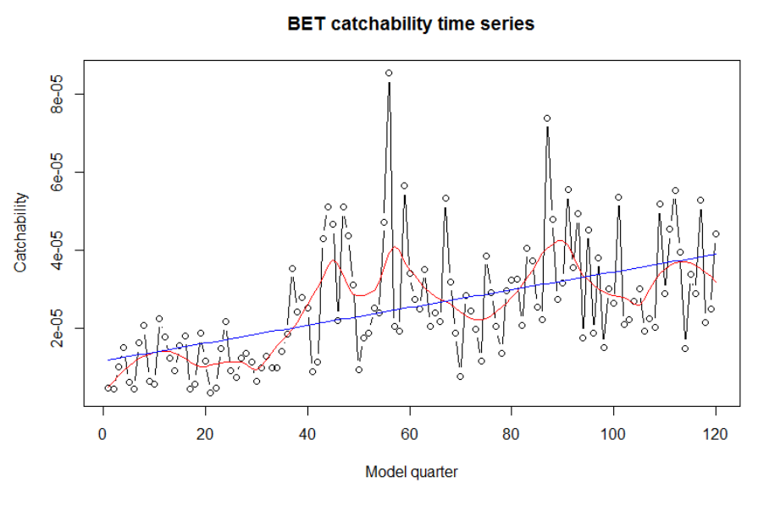
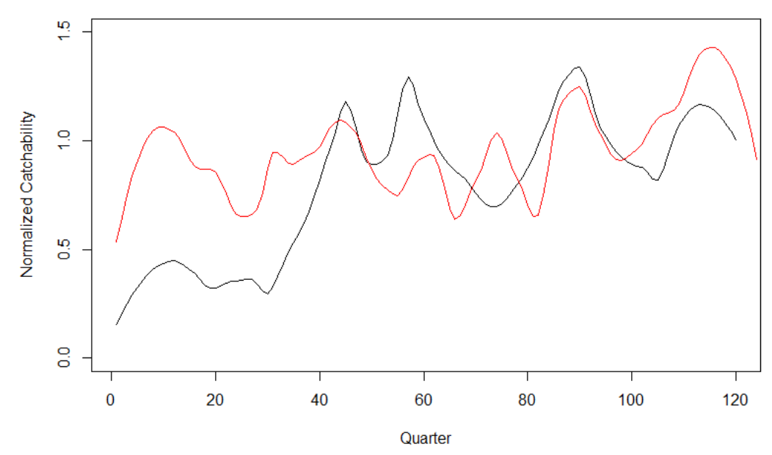
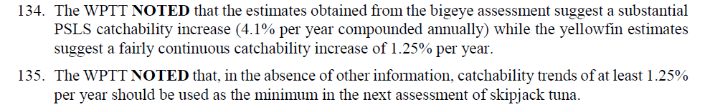
WPTT2018 – 32
WPTT 2018 Report

